Slide 1
HW1-人物設定

Slide 2
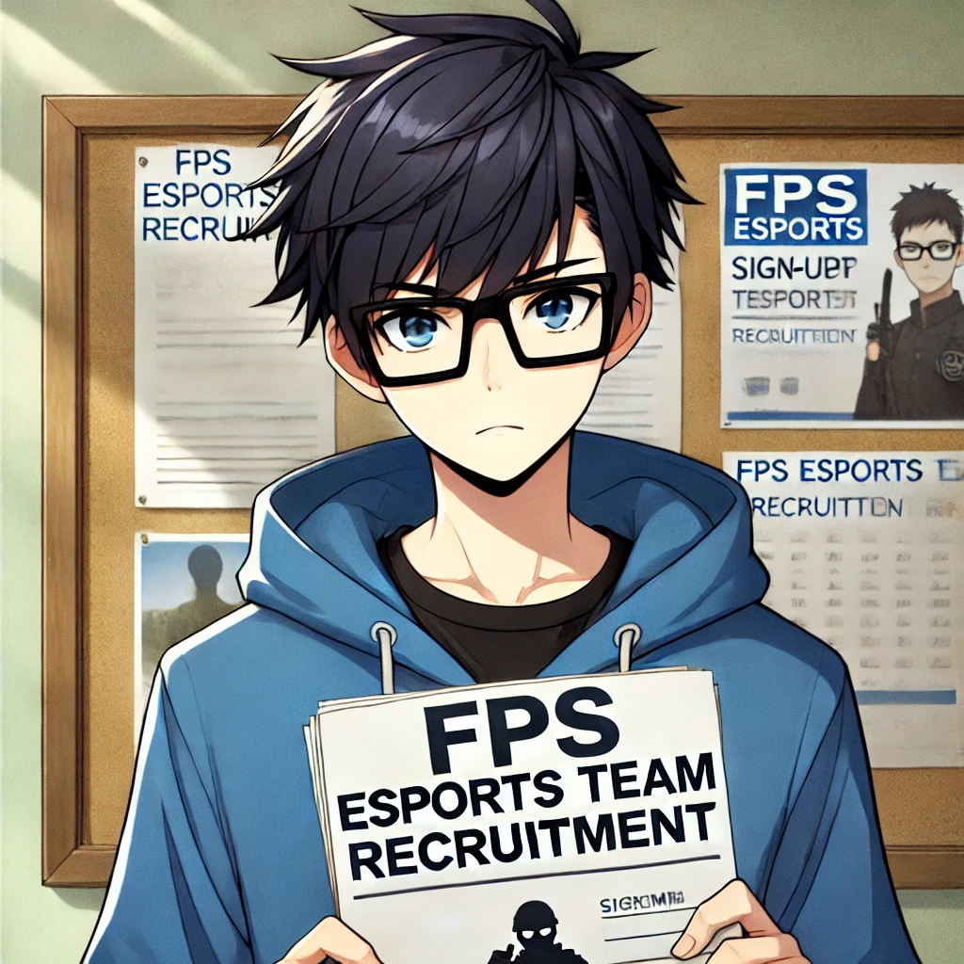

目標
Notes:
text to image
A young male character with short, black hair , wearing black square-framed glasses. The character is wearing a blue hoodie.The style is anime-inspired.
He stands in front of a school bulletin board. He looks determined as he holds a sign-up sheet for an FPS esports team recruitment

Slide 3
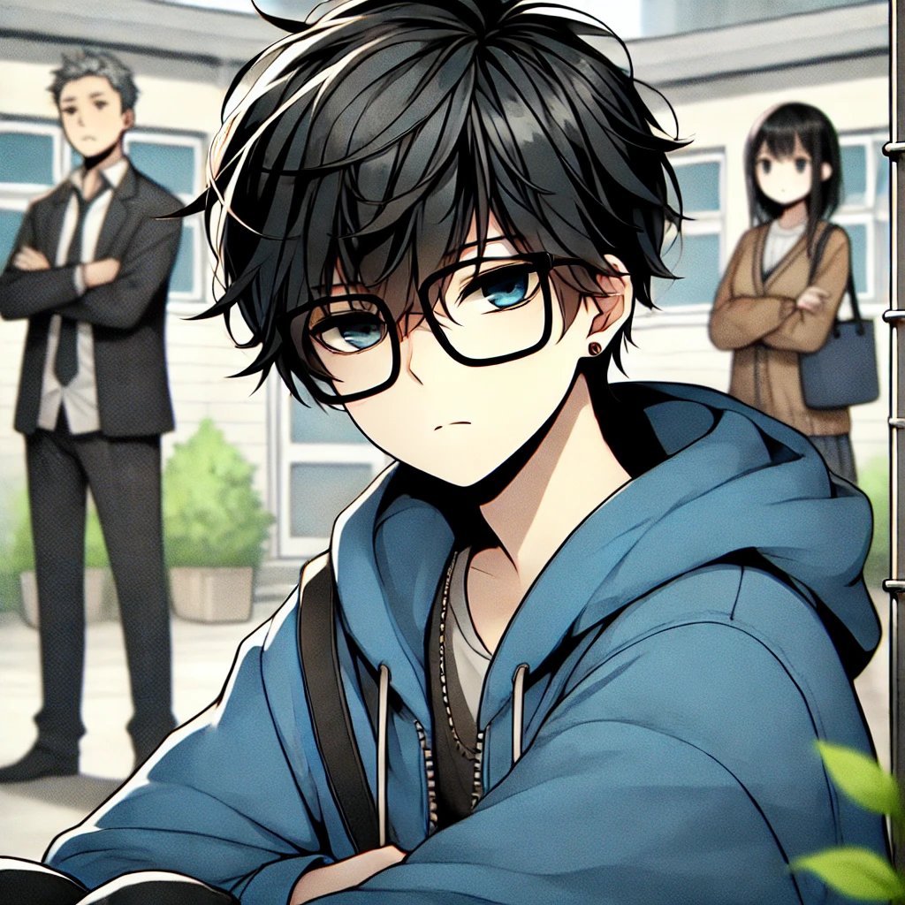
阻礙
Notes:
text to image
A young male character with short, black hair , wearing black square-framed glasses. The character is wearing a blue hoodie.The style is anime-inspired.
He sits in a corner of the school yard, looking down with a sad expression. His parents are in the background, looking disappointed, while the boy clutches a game controller.

Slide 4
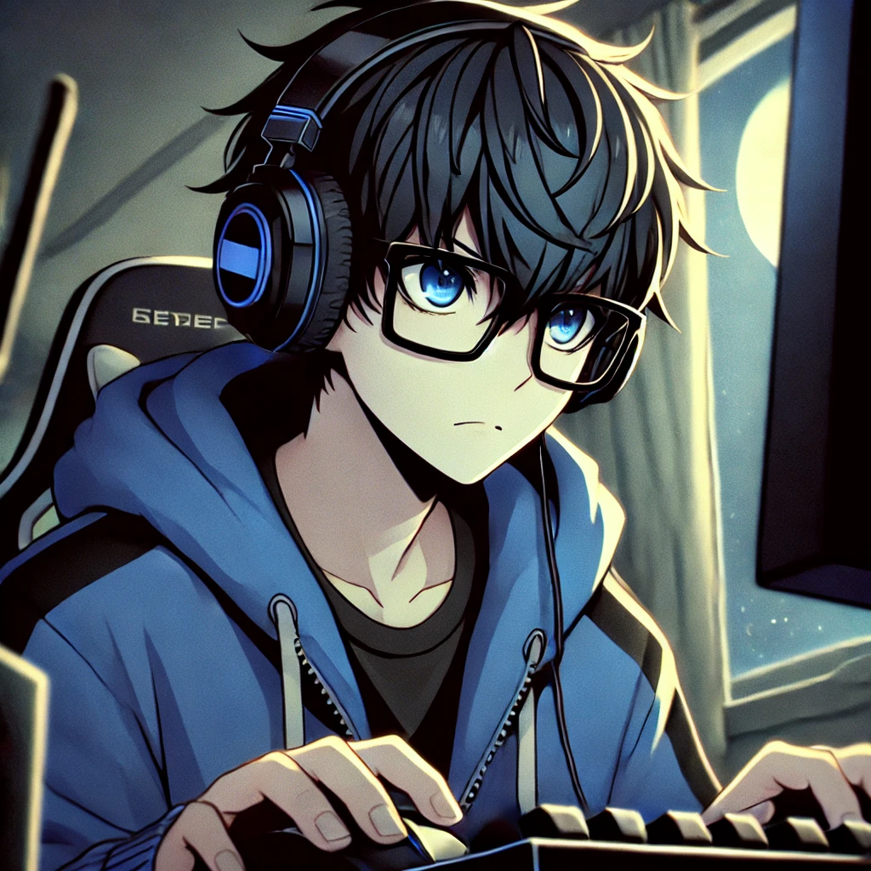
努力
Notes:
text to image
A young male character with short, black hair , wearing black square-framed glasses. The character is wearing a blue hoodie.The style is anime-inspired.
He sits at his computer, focusing intensely on an FPS game. His hands are on the keyboard and mouse, with gaming equipment scattered around, and a window showing moonlight outside.

Slide 5
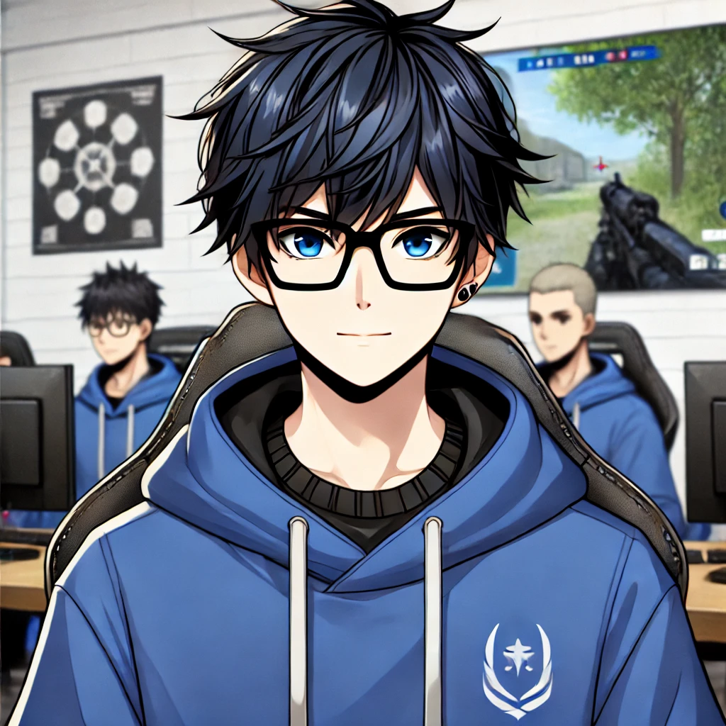
結果
Notes:
text to image
A young male character with short, black hair , wearing black square-framed glasses. The character is wearing a blue hoodie.The style is anime-inspired.
He is in an esports training room with his team. He looks confident as they discuss strategies for an upcoming FPS game tournament.

Slide 6
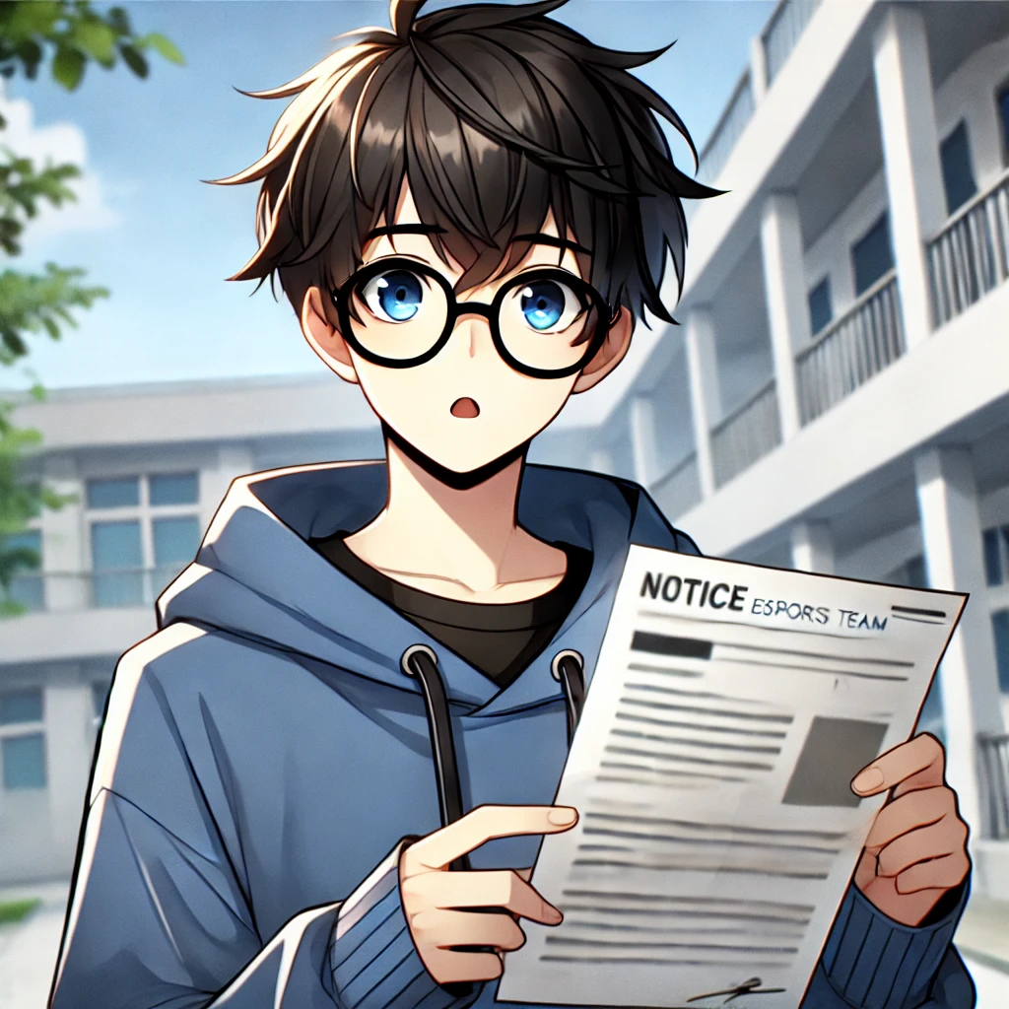
意外
Notes:
text to image
A young male character with short, black hair , wearing black square-framed glasses. The character is wearing a blue hoodie.The style is anime-inspired.
stands in an empty school yard, looking shocked as he reads a notice about the esports team’s funding being cut

Slide 7
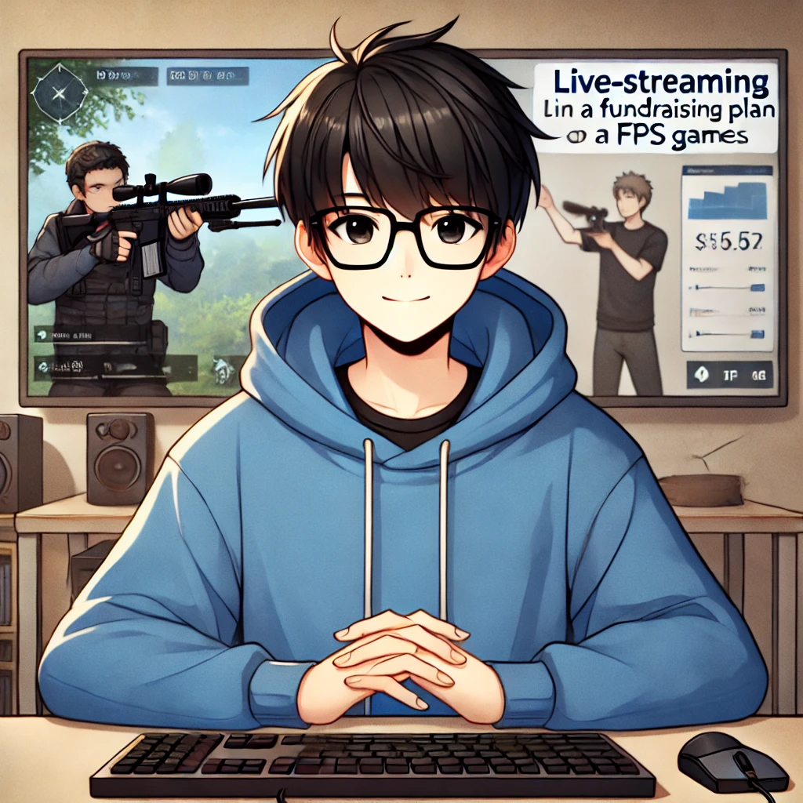
轉彎
Notes:
text to image
A young male character with short, black hair , wearing black square-framed glasses. The character is wearing a blue hoodie.The style is anime-inspired.
He is now sitting in a simple room, live-streaming on his computer. He explains a fundraising plan while his teammates practice FPS games in the background.

Slide 8
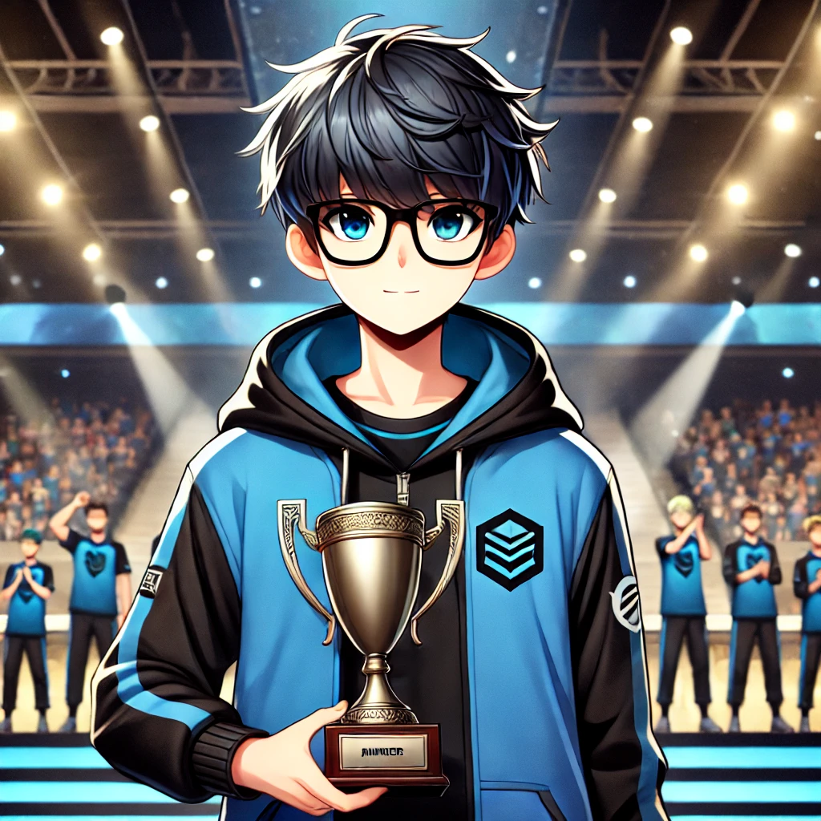
結局
Notes:
text to image
A young male character with short, black hair , wearing black square-framed glasses. The character is wearing a blue hoodie.The style is anime-inspired.
He stands proudly on a large esports tournament stage, holding a runner-up trophy with his teammates. The stage is lit up, and the audience is cheering

